Slide 1
LA County’s
Homeless Initiative
and
Measure H
Los Angeles City/County Native American Commission
Community Forum on Homelessness
September 25, 2018

Slide 2
Measure H - Big Picture
We are making progress, but…
Making tremendous headway in a short amount of time, but we are working to reverse 40 years of underinvestment in addressing homelessness
Homelessness takes time to resolve. People’s lives are messy. We are ending homelessness one person at a time for tens of thousands of people.
Hundreds of new people become homeless each month. We have to be realistic about what we can do in the face of the inflow into homelessness.

Slide 3
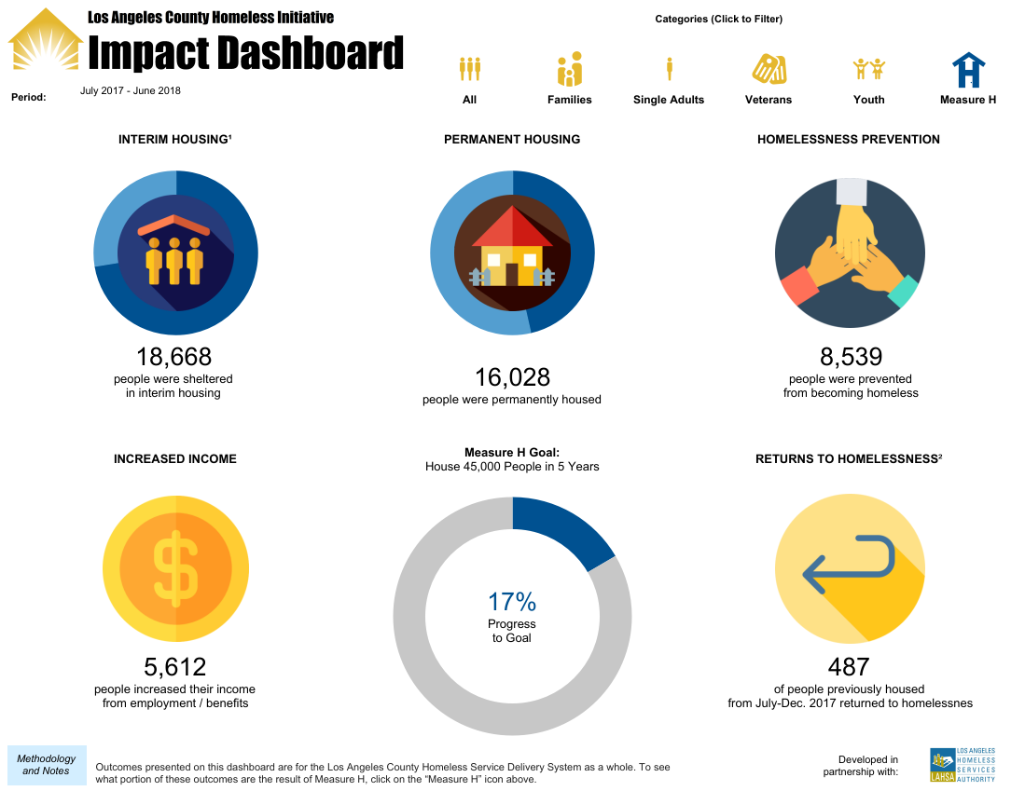
Measure H - Dashboard
homeless.lacounty.gov/impact-dashboard/

Slide 4
Major FY 2018-19 Measure H Funding Commitments
On May 15, the Board of Supervisors allocated $402 million in Measure H funding for FY 2018-19, including:
PREVENTION $17 million | OUTREACH $30 million | PERMANENT SUPPORTIVE HOUSING $49 million | RAPID RE-HOUSING $73 million
SHELTER / INTERIM HOUSING $120 million ($20 million increase from tentative allocation)

Slide 5
Where does Measure H go?
LAHSA
LAHSA & DHS
DHS & CDC
LAHSA & DHS
PREVENTION $17 million | OUTREACH $30 million | PERMANENT SUPPORTIVE HOUSING $49 million | RAPID RE-HOUSING $73 million
SHELTER / INTERIM HOUSING $120 million ($20 million increase from tentative allocation)
LAHSA & DHS
CBOs

Slide 6
The Players
LAHSA – Los Angeles Homeless Services Authority
DHS- LA County Department of Health Services
CDC- LA County Community Development Commission
Community Based Organizations
homeless.lacounty.gov/measure-h-funded-contracts/

Slide 7
Homeless Initiative Strategies
The Big Strategies
Prevention
Coordinated Entry System
Outreach
Benefits Advocacy
Rapid Re-Housing
Interim Housing
Permanent Supportive Housing
The Smaller Strategies
The Unfunded, but Important Strategies

Slide 8
Homeless Initiative Strategies
The Smaller Strategies
TAY
Federal Housing Subsidies
Employment
SSI Housing
DCFS Family Reunification
Jail In-Reach
Criminal Record Clearing
Regional Re-Entry Networks
The Unfunded, but Important Strategies

Slide 9
Homeless Initiative Strategies
Some of the Unfunded, but Important Strategies:
Discharges from Foster Care and Probation
First Responders Training
Decriminalization Policy
ADU Pilot
Inclusionary Zoning

Slide 10
LA-HOP
www.lahsa.org/portal/apps/la-hop/

Slide 11
Additional Measure H Resources
Homeless Initiative - http://homeless.lacounty.gov/
Jobs Combatting Homelessness
JobsCombattingHomelessness.org

Slide 12
Contact Info
Molly Rysman
mrysman@bos.lacounty.gov
(213) 974-3333

